Slide 1
Azure Cloud Adoption Framework
Scenario 1: Secured Azure vWAN hub with default route propagation
When you need traffic inspection between Azure VMware Solution and the internet, but not between Azure VMware Solution and on-prem
Scenario 2: Third-party NVAs inspecting all network traffic
When you need a security appliance, traffic inspection, and Global Reach is not available
Scenario 3: Egress from Azure VMware Solution with NSX-T DC or NVA within Azure VMware Solution
When you need to use NSX-T DC or an Azure VMware Solution-hosted NVA for traffic inspection
Scenario 4: Third-party NVAs in hub with Azure Route Server
When you need to inspect traffic between Azure VMware Solution and internet, and between Azure VMware Solution and VNets
https://learn.microsoft.com/en-us/azure/cloud-adoption-framework/scenarios/azure-vmware/example-architectures

Slide 2

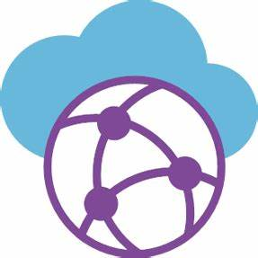

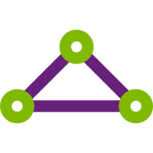



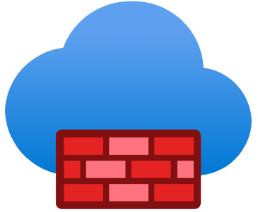


Scenario 1 - Secured vWAN hub with default route propagation
Microsoft Azure
Azure ExpressRoute
Dedicated Microsoft
Enterprise Edge (D-MSEE)
Azure ExpressRoute
Gateway A
Azure Secured vWAN
Hub
Azure VMware Solution
Private Cloud
ExpressRoute Connection
Azure Firewall
Default Route
Global Reach
ExpressRoute Connection
Internet
Microsoft
Enterprise Edge (MSEE)
Azure Hub VNet)
Azure Firewall
(WAF)
ExpressRoute Connection
Azure ExpressRoute
Gateway B
User Defined Routes
VNet Peering
Spoke VNets
Azure ExpressRoute
Customer Data Center
(On-Premises, or Co-Lo)
Azure Default Route blocked
by Route Policy
Customer Edge
Router

Slide 3



Scenario 2 - Third-party NVAs inspecting all network traffic
Microsoft Azure
Azure ExpressRoute
Dedicated Microsoft
Enterprise Edge (D-MSEE)
Azure ExpressRoute
Gateway A
Azure Transit VNet
Azure VMware Solution
Private Cloud
ExpressRoute Connection
Azure Route
Server
NVA
(Transit)
User Defined Routes
VNet Peering
Internet
Microsoft
Enterprise Edge (MSEE)
Azure Hub VNet
ExpressRoute Connection
Azure Route
Server
NVA
(FW)
Azure ExpressRoute
Gateway B
User Defined Routes
VNet Peering
Spoke VNets
Azure ExpressRoute
Customer Data Center
(On-Premises, or Co-Lo)
Azure Default Route blocked
by Route Policy
Customer Edge
Router

Slide 4
Scenario 3 - Egress with NSX-T DC or hosted NVA
Microsoft Azure
Azure ExpressRoute
Dedicated Microsoft
Enterprise Edge (D-MSEE)
Azure ExpressRoute
Gateway A
Azure Secured vWAN
Hub
Azure VMware Solution
Private Cloud
ExpressRoute Connection
NVA
(FW)
Azure Firewall
Default Route
Global Reach
ExpressRoute Connection
Internet
Microsoft
Enterprise Edge (MSEE)
Azure Hub VNet)
Internet
(Managed SNAT)
Azure Firewall
(WAF)
ExpressRoute Connection
Azure ExpressRoute
Gateway B
User Defined Routes
VNet Peering
Spoke VNets
Azure ExpressRoute
Customer Data Center
(On-Premises, or Co-Lo)
Azure Default Route blocked
by Route Policy
Customer Edge
Router

Slide 5
Scenario 4 - Third-party NVAs in hub with Azure Route Server
Microsoft Azure
Azure ExpressRoute
Dedicated Microsoft
Enterprise Edge (D-MSEE)
Azure VMware Solution
Private Cloud
Global Reach
ExpressRoute Connection
Internet
Microsoft
Enterprise Edge (MSEE)
Azure Hub VNet
ExpressRoute Connection
Azure Route
Server
NVA
(FW)
Azure ExpressRoute
Gateway
User Defined Routes
VNet Peering
Spoke VNets
Azure ExpressRoute
Customer Data Center
(On-Premises, or Co-Lo)
Azure Default Route blocked
by Route Policy
Customer Edge
Router

